Slide 1
Data Quality
Created By: Jeffery A. Shaffer Vice President, Unifund Adjunct Faculty, University of Cincinnati (513) 615-0001 | JeffreyShaffer@gmail.com @HighVizAbility
Notes:
Title Slide

Slide 2
Goals
By completing the course modules, students will:
Understand the importance of data quality
Learn the basic data models
Understand how to create a data set that is suitable for analysis

Slide 3
Data Quality
Why do we care about data quality in this class?
Notes:
NOTE:
The purpose of this section is to show the importance of good data quality. Garbage in is garbage out. There are examples of real-world data issues encountered as well as the fundamental concepts around data modeling.

Slide 4
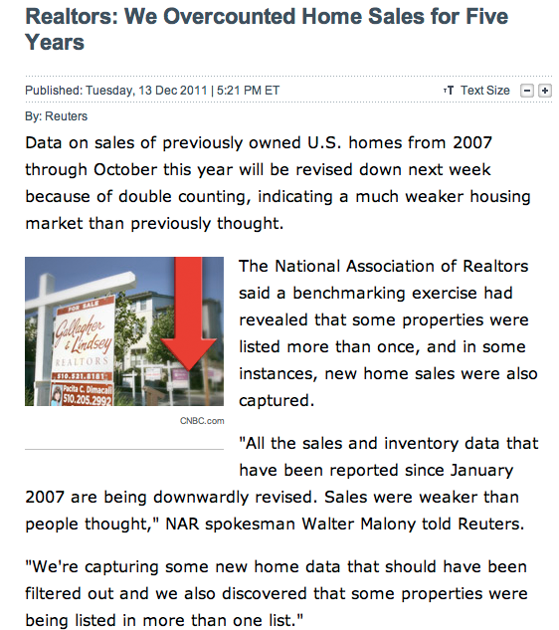
Be Vigilant: Question the Data
Notes:
Here is a press release from 2011. This is after the financial crisis which was driven primarily by a mortgage crisis. The National Association of Realtors, known as they NAR, has some of the best economists in the world constantly studying and publishing about the real estate market. Their numbers are published regularly and the market uses those numbers as a common guide for how things are in the housing market. But there’s a major issue here. In December 2011, they announced that they had found an error in their numbers. As it turns out it was a major error. From 2007, pre-recession, through the end of 2011 they were double counting sales of certain homes. As a result, they had to revise all of their sales numbers down. How did this happen? How did an organization with world-class talent make a mistake like this?
The data for the homes sales is collected in the Multiple Listing Service, or MLS. These MLS systems across the country gather and report the data for their area. The issue arises when homes are on the borders of the MLS. There were homes entered into two or more MLS systems, so that when the house was reported as sold, it was reported by more than one MLS system and double counted.

Slide 5

The Data Quality Challenge!
The cost of bad data exceeds $600B for US businesses annually
Nearly 50% say data quality is the greatest barrier to realizing value from business analytics
Poor data has been cited as the number one reason for project overruns
For a medium sized Fortune 1000 company, a 10% increase in data usability would increase revenue by $2B
Quality
Reliability
Service
Efficiency
Source: https://www2.deloitte.com/content/dam/Deloitte/xe/Documents/technology/dme_tech_are_you_a_data_driven_organization.pdf
Notes:
The lesson here is “Never Trust the Data”. If you want to be more precise about that statement, you could, “Never trust the assumption of the data.” If you are tasked with looking at data, you have to challenge it, question it, question the source, dig in and explore that data. Remember John Tukey, the guy that invented the box plot. He also invented the idea of Exploratory Data Analysis, or EDA. EDA can help you find insight into the data, but it can also help you explore the quality and veracity of the data.

Slide 6
Good data is clean, relevant, trusted, and can be leveraged.

Slide 7
The Data Quality Challenge!
Question: Where do my highest value subscribers live?
Database Field | Source #1 | Source #2 | Source #3
City | Cinainnati | Cincinnati | Cincinnatti
State | Ohio | OH | O
Cincinnati and Ohio will show up as three different locations.
Question: Which subscribers should I try to reactivate?
Customer Name | Address | Phone | Email
John Smith | 123 Lovely Lane | (513) 456-7890 | jsmith@hotmail.com
J Smith Jr. | 123 Lovely Lane | (513) 602-1234 | jsmith@hotmail.com
John Smith | 123 Lovely Lane #2 | (513) 602-1234 | coolguy@gmail.com
The database will treat these records as separate individuals. Are they?

Slide 8
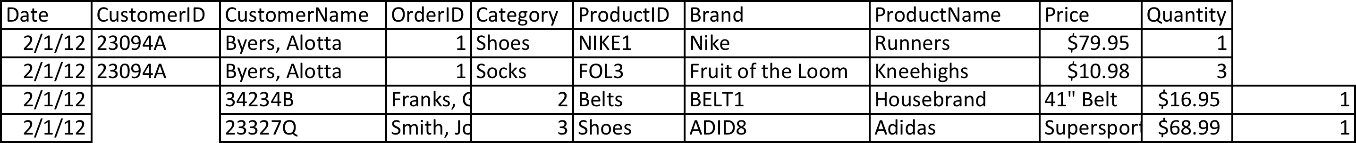
The dangers of Excel as a database Many businesses use Excel to store their data. This can lead to disasters!
Disaster #1: Copy/Paste Errors
When copy/pasting data into Excel, it’s easy to miss the target or overwrite the wrong cells.

Slide 9
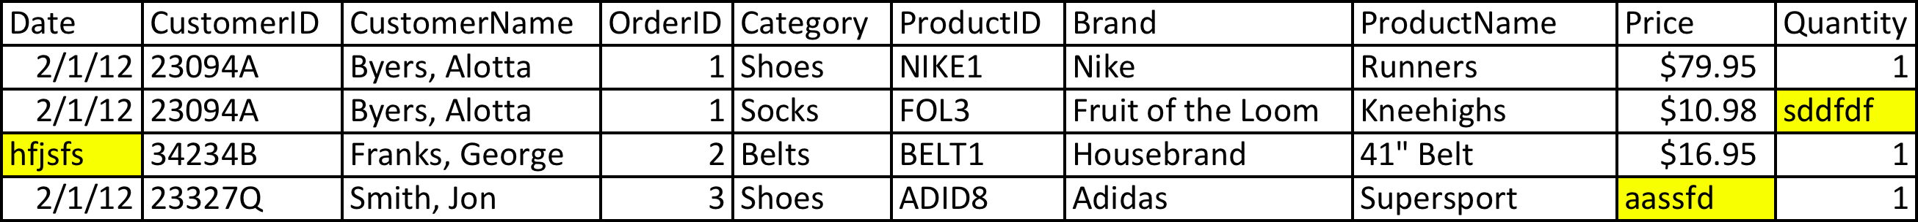
The dangers of Excel as a database Many businesses use Excel to store their data. This can lead to disasters!
Disaster #2: Mixed-up data types
Excel doesn’t enforce consistent data types in each column; this can lead to problems in loading for analysis.

Slide 10
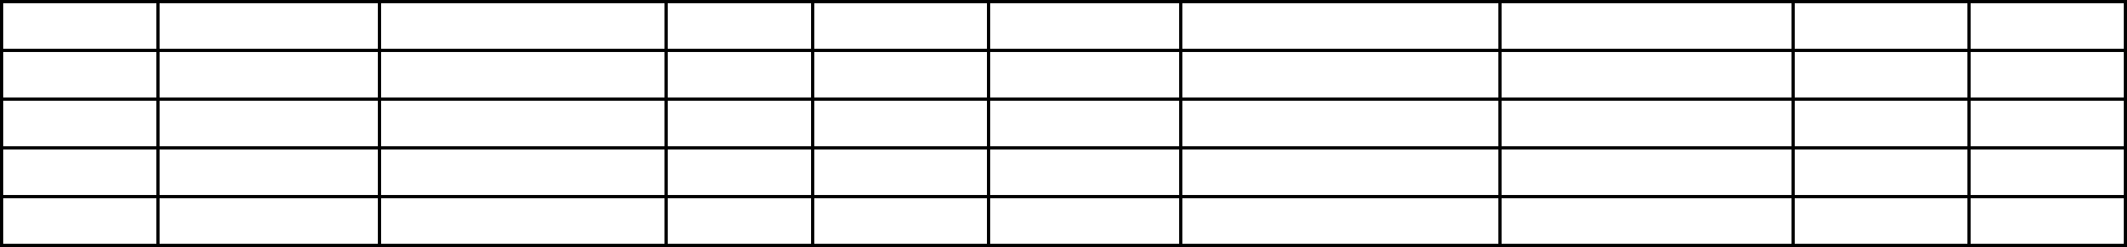
The dangers of Excel as a database Many businesses use Excel to store their data. This can lead to disasters!
Disaster #3: Ooops. Deleted it.
It’s easy to mix up or lose track of which version is right.

Slide 11
Creating a Good Data Set Technical Challenges

Slide 12
Acquiring Your Data
Data can be provided in variety of methods:
Flat file (typically delimited)
Query to transactional system
Operational data store
Data warehouse
More importantly… The method by which the data is modeled has a larger impact on your ability to use it for analysis.

Slide 13
Transactional Modeling
Data typically housed in a relational database
Data model is normalized to eliminate data redundancy
Used in day-to-day online transaction processing (OLTP) systems
Typically used for day-to-day operational systems
Good for “data in”
Challenges with data visualization:
“Data out” can be complex and slow
Limited ability to support complex analytical needs with good performance

Slide 14
Transactional Data Model Sample
Order_Date | Order_ID | Customer_ID | Order_Status
1/2/14 | 234231 | 22352 | C
1/2/14 | 234232 | 346346 | O
1/2/14 | 234233 | 42342 | O
1/3/14 | 234234 | 234622A | N
1/4/14 | 234235 | PG23421 | B
Order_Master Table
Customer_ID Table
Customer_ID | First_Name | Last_Name | Status | First_Date | Address_ID
22352 | Freda | Pay | Active | 5/29/73 | 234321
346346 | Shirley | Gross | Closed | (N/A) | 634244
42342 | Bob | Ferapples | Active | 1/2/03 | 435324
Order_ID | Payment_Terms | Item_Count | Order_Updated
234231 | Credit Card | 15 | 1/2/14
234232 | Cash | 10 | 1/2/14
234233 | COD | 2 | 1/2/14
234234 | Credit Card | 3 | 1/3/14
234235 | Finance | 5 | 1/4/14
Order_Summary Table
Common keys are used to link concepts.
Order_ID | Item_ID | Item_Cost | Item_Retail | Discount | Taxable | Quantity
234231 | A123 | 14.95 | 29.9 | 0 | T | 5
234231 | B32 | 62.11 | 124.22 | 0 | T | 1
234231 | CUCME | 9.99 | 19.98 | 0 | X | 2
234231 | QRZ | 45.98 | 91.96 | 0 | T | 3
234231 | CQCQ | 16.12 | 32.24 | 0 | T | 1
234231 | X999 | 14.98 | 29.96 | 0 | X | 3
Order_Detail Table
Notes:
In this example of a transactional data model there is a Master Order Table, a Customer ID Tableu with the customer names, an Order ID table with a summary of each order ID and finally an order ID table that has the details for each order. The Order master table is linked to the customer ID table on the field Customer ID, which is a key used to link them. The Order ID links to the order summary table in a one to one relationship, but then the summary links to the detailed table in a one to many relationship.

Slide 15
Transactional Data Model Sample
Notes:
Here is an example of a typical Operational Data Store or ODS. Note the numerous data relationships and number of joins required if a report needed to combine SalesPerson information with SpecialOffers.
You can see this can get start to get complex very quickly and this is a relatively small data model.

Slide 16
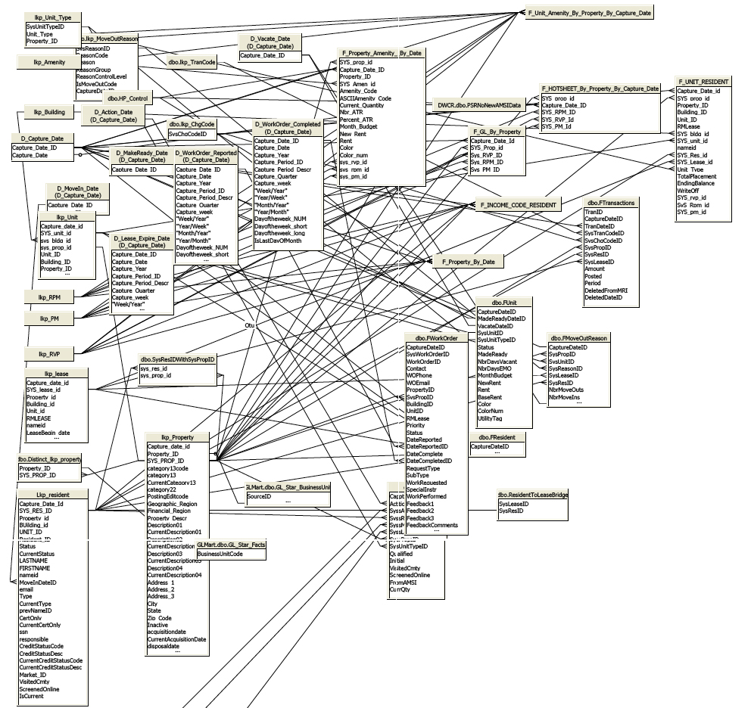
Relational models often don’t work for analysis
An actual model encountered on a project
Notes:
Here is an example of an actual data model encountered on a project. Now imagine that you are tasked with creating rapid reporting from this data for the business.

Slide 17
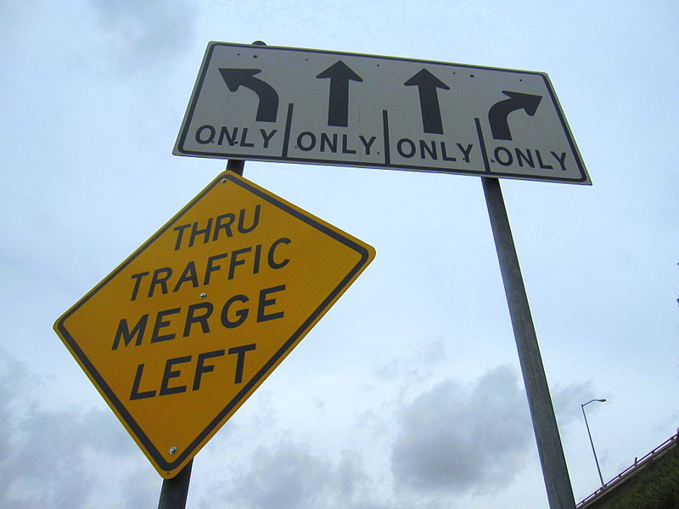
Notes:
It’s often not clear where the road will lead when starting out….
----------------------
Public Domain: https://commons.wikimedia.org/wiki/File:Confusing_street_signs.jpg

Slide 18
Analytical Data Modeling
Denormalized data model
Adds redundant data for grouping and filtering
Data may be stored in a multi-dimensional database (cube), in a single or small number of “wide” tables
Used in online analytical processing (OLAP)
Good for “data out”
Optimized for reporting and analysis
Related to data visualization:
Data redundancy makes for a rich analysis
Good for answering new questions
Resembles the business
Can be aggregated

Slide 19
Analytical Data Modeling
Two fundamental building blocks:
Dimensions = made up of textual attributes
Not countable
Can be used to group, filter, and build hierarchies
Measures = numeric facts
Countable
Typically additive
Select sum(Sales) where Region = “East” group by State order by State
Notes:
Dimensions and measures (or facts) are the fundamental building block for data analysis. (Note: Tableau also organize the data by dimension and measures). Dimensions might be categories or segments, or regions of the country, for example, north, south, east and west. Measures might be sales, profit, inventory, graduation rate or simple a count of the number of people or things in the data.
In a database query we see the dimension used as a group by or filter. In the example at the bottom, the query selects the sum of a measure, which is sales, filters by the dimension Region and then groups and orders by another dimension of State.

Slide 20
Analytical Data Model Sample
Snowflake
This model is also referred to as a star schema because of its shape. Countable metrics are in the central fact table and link directly to the business concepts in the surrounding dimension tables.
Notes:
Star Schema Design - In the star schema design, a single fact table sits in the middle and is connected to other surrounding objects (dimension lookup tables) like a star. Each dimension is represented as a single table. The primary key in each dimension table is related to a foreign key in the fact table. All measures in the fact table are related to all the dimensions that fact table is related to. In other words, they all have the same level of granularity. Assume our data warehouse keeps sales data, and the different dimensions are date, product, promotion, territory, customer, and currency. In this case, the figure represents our star schema. The lines between tables indicate that there is a primary key / foreign key relationship between the tables. Note the dimensions are not related to each other.

Slide 21
Let’s simplify
For a data set that works well in both Excel and Tableau, create a single table that contains all the attributes and measures to analyze…
Date | CustomerID | CustomerName | OrderID | Category | ProductID | Brand | ProductName | AgentID | AgentName | Price | Quantity
2/1/12 | 23094A | Byers, Alotta | 1 | Shoes | NIKE1 | Nike | Runners | 101 | Pay, Freda | $79.95 | 1
2/1/12 | 23094A | Byers, Alotta | 1 | Socks | FOL3 | Fruit of the Loom | Kneehighs | 101 | Pay, Freda | $10.98 | 3
2/1/12 | 34234B | Franks, George | 2 | Belts | BELT1 | Housebrand | 41" Belt | 101 | Pay, Freda | $16.95 | 1
2/1/12 | 23327Q | Smith, Jon | 3 | Shoes | ADID8 | Adidas | Supersport | 101 | Pay, Freda | $68.99 | 1
2/2/12 | 34634A | Fields, Mary | 4 | Socks | FOL3 | Fruit of the Loom | Anglehighs | 102 | Merkle, Fred | $6.98 | 3
2/3/12 | 34634A | Fields, Mary | 4 | Sandals | KEEN7 | Keen | Desert Walker | 102 | Merkle, Fred | $82.98 | 1
2/3/12 | 34634A | Fields, Mary | 4 | Sandals | KEEN8 | Keen | Night Runner | 102 | Merkle, Fred | $69.98 | 2
2/3/12 | 67657T | Geld, Reginald | 5 | Ties | TIE8 | Housebrand | Yellow Polkadot | 101 | Pay, Freda | $22.79 | 1
2/3/12 | 34543A | Turner, Rod | 6 | Socks | CHMP3 | Champion | Athletic Sport | 101 | Pay, Freda | $7.98 | 4
Which are dimensions and which are measures?
Notes:
[Ask the class to identify which of these are dimensions and which are measures]

Slide 22
Let’s simplify
For a data set that works well in both Excel and Tableau, create a single table that contains all the attributes and measures to analyze…
Date | CustomerID | CustomerName | OrderID | Category | ProductID | Brand | ProductName | AgentID | AgentName | Price | Quantity
2/1/12 | 23094A | Byers, Alotta | 1 | Shoes | NIKE1 | Nike | Runners | 101 | Pay, Freda | $79.95 | 1
2/1/12 | 23094A | Byers, Alotta | 1 | Socks | FOL3 | Fruit of the Loom | Kneehighs | 101 | Pay, Freda | $10.98 | 3
2/1/12 | 34234B | Franks, George | 2 | Belts | BELT1 | Housebrand | 41" Belt | 101 | Pay, Freda | $16.95 | 1
2/1/12 | 23327Q | Smith, Jon | 3 | Shoes | ADID8 | Adidas | Supersport | 101 | Pay, Freda | $68.99 | 1
2/2/12 | 34634A | Fields, Mary | 4 | Socks | FOL3 | Fruit of the Loom | Anglehighs | 102 | Merkle, Fred | $6.98 | 3
2/3/12 | 34634A | Fields, Mary | 4 | Sandals | KEEN7 | Keen | Desert Walker | 102 | Merkle, Fred | $82.98 | 1
2/3/12 | 34634A | Fields, Mary | 4 | Sandals | KEEN8 | Keen | Night Runner | 102 | Merkle, Fred | $69.98 | 2
2/3/12 | 67657T | Geld, Reginald | 5 | Ties | TIE8 | Housebrand | Yellow Polkadot | 101 | Pay, Freda | $22.79 | 1
2/3/12 | 34543A | Turner, Rod | 6 | Socks | CHMP3 | Champion | Athletic Sport | 101 | Pay, Freda | $7.98 | 4
Attributes provide ways to group, organize, categorize, filter, and segment the data…

Slide 23
Let’s simplify
For a data set that works well in both Excel and Tableau, create a single table that contains all the attributes and measures to analyze…
Date | CustomerID | CustomerName | OrderID | Category | ProductID | Brand | ProductName | AgentID | AgentName | Price | Quantity
2/1/12 | 23094A | Byers, Alotta | 1 | Shoes | NIKE1 | Nike | Runners | 101 | Pay, Freda | $79.95 | 1
2/1/12 | 23094A | Byers, Alotta | 1 | Socks | FOL3 | Fruit of the Loom | Kneehighs | 101 | Pay, Freda | $10.98 | 3
2/1/12 | 34234B | Franks, George | 2 | Belts | BELT1 | Housebrand | 41" Belt | 101 | Pay, Freda | $16.95 | 1
2/1/12 | 23327Q | Smith, Jon | 3 | Shoes | ADID8 | Adidas | Supersport | 101 | Pay, Freda | $68.99 | 1
2/2/12 | 34634A | Fields, Mary | 4 | Socks | FOL3 | Fruit of the Loom | Anglehighs | 102 | Merkle, Fred | $6.98 | 3
2/3/12 | 34634A | Fields, Mary | 4 | Sandals | KEEN7 | Keen | Desert Walker | 102 | Merkle, Fred | $82.98 | 1
2/3/12 | 34634A | Fields, Mary | 4 | Sandals | KEEN8 | Keen | Night Runner | 102 | Merkle, Fred | $69.98 | 2
2/3/12 | 67657T | Geld, Reginald | 5 | Ties | TIE8 | Housebrand | Yellow Polkadot | 101 | Pay, Freda | $22.79 | 1
2/3/12 | 34543A | Turner, Rod | 6 | Socks | CHMP3 | Champion | Athletic Sport | 101 | Pay, Freda | $7.98 | 4
Dimensions provide methods to group, organize, categorize, filter, and segment the data
Measures give the quantities and amounts for analysis

Slide 24
Let’s simplify
For a data set that works well in both Excel and Tableau, create a single table that contains all the attributes and measures to analyze…
Date | CustomerID | CustomerName | OrderID | Category | ProductID | Brand | ProductName | AgentID | AgentName | Price | Quantity
2/1/12 | 23094A | Byers, Alotta | 1 | Shoes | NIKE1 | Nike | Runners | 101 | Pay, Freda | $79.95 | 1
2/1/12 | 23094A | Byers, Alotta | 1 | Socks | FOL3 | Fruit of the Loom | Kneehighs | 101 | Pay, Freda | $10.98 | 3
2/1/12 | 34234B | Franks, George | 2 | Belts | BELT1 | Housebrand | 41" Belt | 101 | Pay, Freda | $16.95 | 1
2/1/12 | 23327Q | Smith, Jon | 3 | Shoes | ADID8 | Adidas | Supersport | 101 | Pay, Freda | $68.99 | 1
2/2/12 | 34634A | Fields, Mary | 4 | Socks | FOL3 | Fruit of the Loom | Anglehighs | 102 | Merkle, Fred | $6.98 | 3
2/3/12 | 34634A | Fields, Mary | 4 | Sandals | KEEN7 | Keen | Desert Walker | 102 | Merkle, Fred | $82.98 | 1
2/3/12 | 34634A | Fields, Mary | 4 | Sandals | KEEN8 | Keen | Night Runner | 102 | Merkle, Fred | $69.98 | 2
2/3/12 | 67657T | Geld, Reginald | 5 | Ties | TIE8 | Housebrand | Yellow Polkadot | 101 | Pay, Freda | $22.79 | 1
2/3/12 | 34543A | Turner, Rod | 6 | Socks | CHMP3 | Champion | Athletic Sport | 101 | Pay, Freda | $7.98 | 4
Dimensions provide methods to group, organize, categorize, filter, and segment the data
Measures give the quantities and amounts for analysis

Slide 25
Let’s simplify
For a data set that works well in both Excel and Tableau, create a single table that contains all the attributes and measures to analyze…
Date | CustomerID | CustomerName | OrderID | Category | ProductID | Brand | ProductName | AgentID | AgentName | Price | Quantity
2/1/12 | 23094A | Byers, Alotta | 1 | Shoes | NIKE1 | Nike | Runners | 101 | Pay, Freda | $79.95 | 1
2/1/12 | 23094A | Byers, Alotta | 1 | Socks | FOL3 | Fruit of the Loom | Kneehighs | 101 | Pay, Freda | $10.98 | 3
2/1/12 | 34234B | Franks, George | 2 | Belts | BELT1 | Housebrand | 41" Belt | 101 | Pay, Freda | $16.95 | 1
2/1/12 | 23327Q | Smith, Jon | 3 | Shoes | ADID8 | Adidas | Supersport | 101 | Pay, Freda | $68.99 | 1
2/2/12 | 34634A | Fields, Mary | 4 | Socks | FOL3 | Fruit of the Loom | Anglehighs | 102 | Merkle, Fred | $6.98 | 3
2/3/12 | 34634A | Fields, Mary | 4 | Sandals | KEEN7 | Keen | Desert Walker | 102 | Merkle, Fred | $82.98 | 1
2/3/12 | 34634A | Fields, Mary | 4 | Sandals | KEEN8 | Keen | Night Runner | 102 | Merkle, Fred | $69.98 | 2
2/3/12 | 67657T | Geld, Reginald | 5 |  | TIE8 | Housebrand | Yellow Polkadot | 101 |  | $22.79 | 1
2/3/12 | 34543A | Turner, Rod | 6 |  | CHMP3 | Champion | Athletic Sport | 101 |  | $7.98 | 4
Sometimes data is not available, or not applicable
Use (UNK) to mark when
or (N/A) in attribute fields, if applicable

Slide 26
Let’s simplify
For a data set that works well in both Excel and Tableau, create a single table that contains all the attributes and measures to analyze…
Date | CustomerID | CustomerName | OrderID | Category | ProductID | Brand | ProductName | AgentID | AgentName | Price | Quantity
2/1/12 | 23094A | Byers, Alotta | 1 | Shoes | NIKE1 | Nike | Runners | 101 | Pay, Freda | $79.95 | 1
2/1/12 | 23094A | Byers, Alotta | 1 | Socks | FOL3 | Fruit of the Loom | Kneehighs | 101 | Pay, Freda | $10.98 | 3
2/1/12 | 34234B | Franks, George | 2 | Belts | BELT1 | Housebrand | 41" Belt | 101 | Pay, Freda | $16.95 | 1
2/1/12 | 23327Q | Smith, Jon | 3 | Shoes | ADID8 | Adidas | Supersport | 101 | Pay, Freda | $68.99 | 1
2/2/12 | 34634A | Fields, Mary | 4 | Socks | FOL3 | Fruit of the Loom | Anglehighs | 102 | Merkle, Fred | $6.98 | 3
2/3/12 | 34634A | Fields, Mary | 4 | Sandals | KEEN7 | Keen | Desert Walker | 102 | Merkle, Fred | $82.98 | 1
2/3/12 | 34634A | Fields, Mary | 4 | Sandals | KEEN8 | Keen | Night Runner | 102 | Merkle, Fred | $69.98 | 2
2/3/12 | 67657T | Geld, Reginald | 5 | (N/A) | TIE8 | Housebrand | Yellow Polkadot | 101 | (UNK) | $22.79 | 1
2/3/12 | 34543A | Turner, Rod | 6 | (N/A) | CHMP3 | Champion | Athletic Sport | 101 | (UNK) | $7.98 | 4
Sometimes data is not available, or not applicable
Use (UNK) to mark when
or (N/A) in attribute fields, if applicable

